Slide 1
Student Registration Form
User Manual

Slide 2
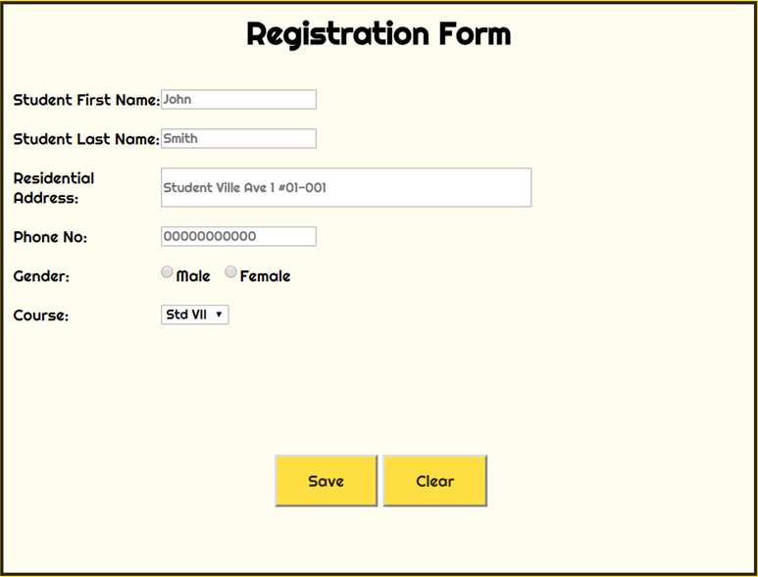
First Look

Slide 3
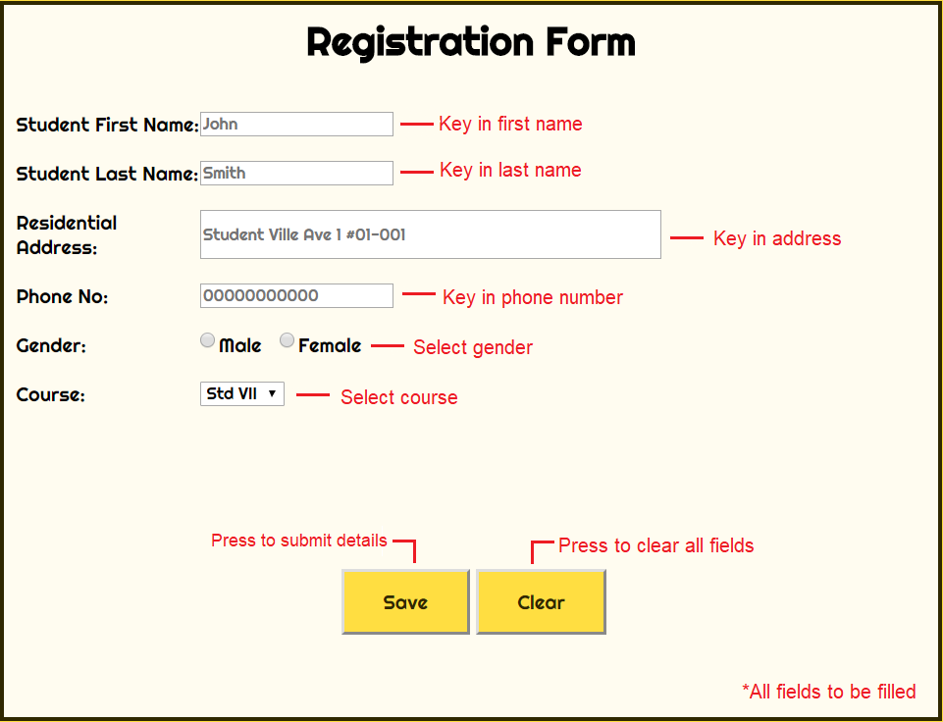
Overview

Slide 4
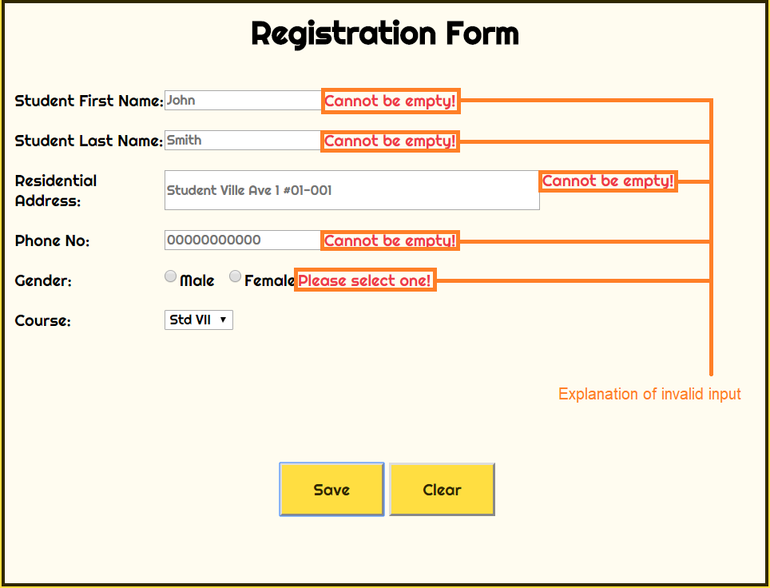
Invalid inputs

Slide 5
Phone number field
Required to be filled
Must only contain numerals (0-9)
To be shorter than 11 characters

Slide 6
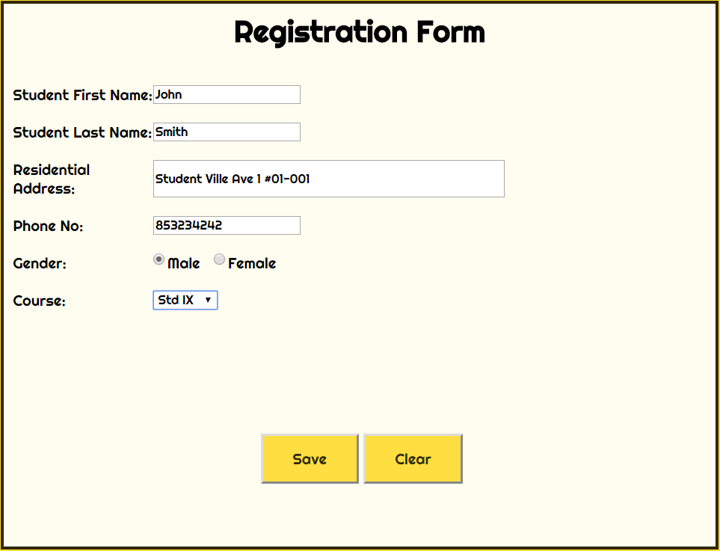
Example of filled form

Slide 7
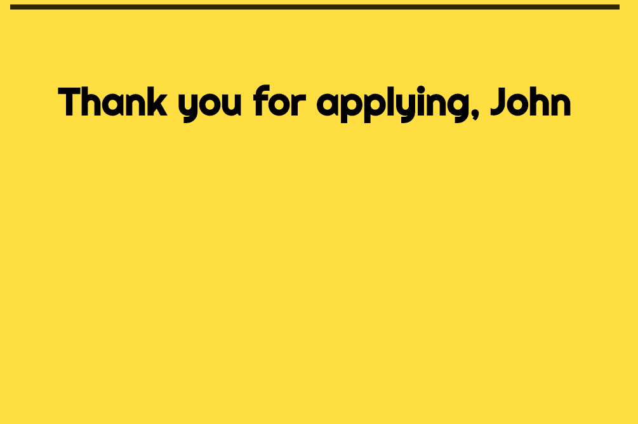
Successful submission

